Slide 1
Introduction to Computing
for the Social Sciences
Session 4 - Programming
David Garcia
Winter Semester 2024-25
13.11.2025

Slide 2
Course Outline
Session 1: Introduction
Session 2: Information Coding
Session 3: Data Structures
Session 4: Programming
Session 5: Algorithms
Session 6: Recursion
Session 7: Sorting Algorithms
Session 8: Time Complexity
Session 9: Formal Languages and Automata
Session 10: Turing Machines and Complexity Classes
Session 11: Databases
Session 12: Parallel Programming
Session 13: Social Science Applications
Session 14: Exam Review

Slide 3
Outline
Fundamentals of programming
Programming paradigms
Good programming practices

Slide 4
What is programming?
Definition
Programming is the process of creating a set of instructions that tell a computer how to perform a task.

Slide 5
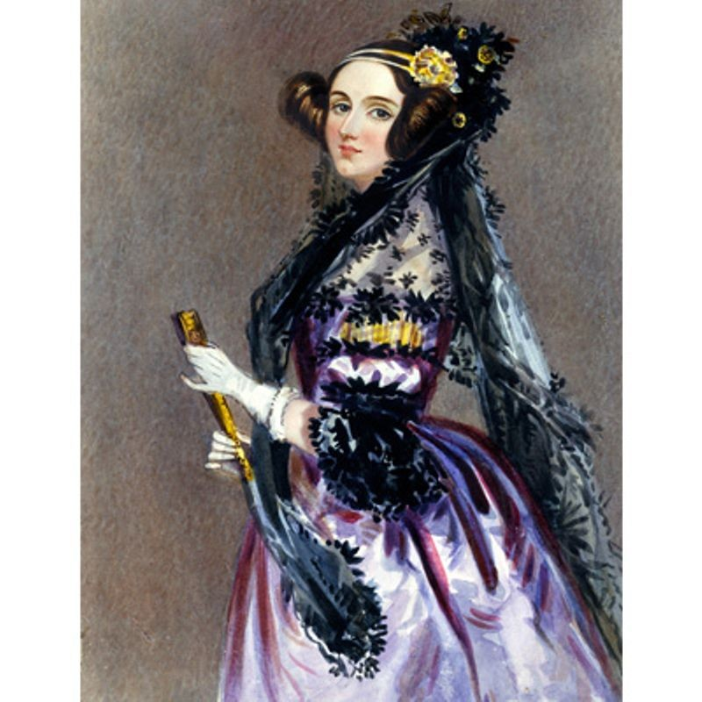
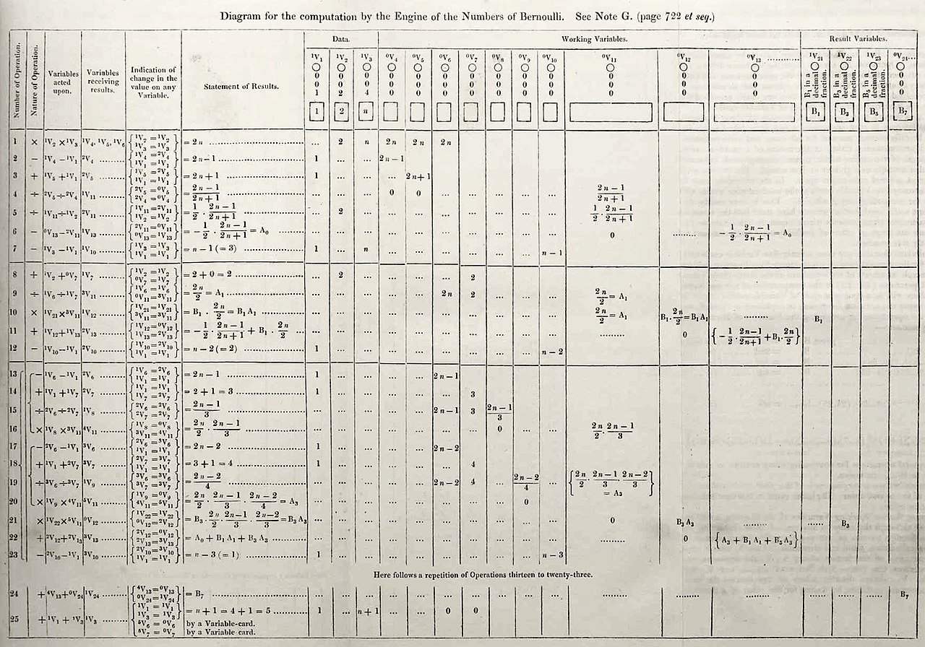
Ada Lovelace: The First Programmer
Augusta Ada King, Countess of Lovelace (1815 - 1852)
Among the first to study Babbage’s Analytical Engine
Babbage never managed to build the Analytical Engine but we know it could perform general computation
She published the first program in a note of a translation of another work
an algorithm for the Analytical Engine to compute Bernoulli numbers
Widely acknowledged as the first programmer
The computer language ADA is named after her

Slide 6
Programming Language
Definition
A programming language is a formal computer language used to communicate instructions to a machine. The instructions (commands) can either be written in machine code or as abstract, human readable source code that is automatically translated to machine code.
The description of a programming language is usually split into the two components of syntax (form) and semantics (meaning).

Slide 7
Types of Programming Languages
Type | Examples | Description
High-level languages | Python, R Java, C, C++, etc.
Low-level languages | Assembly language
 | Machine code

Slide 8
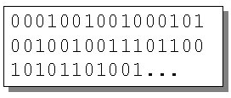
Types of Programming Languages
Type | Examples | Description: Machine code
High-level languages | Python, R Java, C, C++, etc. | Binary code executed by the CPU Each processor/ processor family has its own machine code instruction set
Low-level languages | Assembly language
 | Machine code

Slide 9
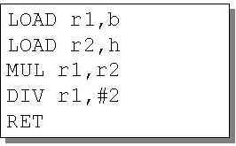
Types of Programming Languages
Type | Examples | Description: Assembly language
High-level languages | Python, R Java, C, C++, etc. | Translated using assembler Human friendly rendition of machine code Mnemonic codes to refer to machine code instructions Symbolic names to refer to storage locations/registers. One instruction translates to one machine code instruction Efficient, less memory, executes faster
Low-level languages | Assembly language
 | Machine code

Slide 10
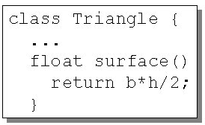
Types of Programming Languages
Type | Examples | Description: High-level languages
High-level languages | Python, R Java, C, C++, etc. | Make reading & writing programs easy for humans Portable (independent of hardware) Not as efficient compared to low-level Rich features - if else, for, while, identifiers, data structures One instruction translates to multiple machine code instructions Translated using a compiler or interpreter
Low-level languages | Assembly language
 | Machine code

Slide 11
Interpreter vs. compiler
Interpreter:
Translates source code into machine code one command/line at a time and immediately executes them
Interpreted every time program runs, no secondary file with machine code is saved
More time to execute => Interpreted code slower than compiled code
Shows errors as soon as it finds them => easier to debug
e.g., Python, Javascript, R

Slide 12
Interpreter vs. compiler
Compiler:
Translates whole source code into compiled/machine code and saves it in a separate file
Whole program needs to compile so slower to test/debug
Once compiled shows list of errors, if any
Compiled programs are faster to run
Users with compiled code can not see the source code or copy it
e.g., C, C++, Java (kind of)

Slide 13
Programming Language
Definition
A programming language is a formal computer language used to communicate instructions to a machine. The instructions (commands) can either be written in machine code or as abstract, human readable source code that is automatically translated to machine code.
The description of a programming language is usually split into the two components of syntax (form) and semantics (meaning).

Slide 14
Programming Language Syntax
Syntax of a (programming) language:
structure:
which characters are allowed in the code?
how can these characters be combined to form valid words?
how can words be composed to form valid “expressions”?
does not specify the meaning of words and expressions
example: natural language
incorrect syntax: Carl soccer eats.
correct syntax: Carl eats soccer.
BUT not meaningful semantics

Slide 15
Programming Language Syntax
Programming language syntax is defined in two parts:
lexical structure
grammatical structure
Example in Python:
syntactically incorrect command
structure of assignment is incorrect: variable on left hand side, then ‘=’, then sum of a and b
syntactically correct command BUT semantic meaning unclear in isolation
x = a b +
x = a + b

Slide 16
Lexical Structure
defines the set of possible character sequences (lexemes) of a token
specifies structure of “words” or tokens
reserved words
if, class, for, …
constants
numbers, e.g., 1, 42, -5, 1.2e5
strings, e.g., “Hello World” (including “”)
special characters
:, +=, +, -,…
identifier
my_function, long_variable_name,…
Notes:
lexical — relating to words or vocabulary of a language

Slide 17
Grammatical Structure
Formally defined, e.g. Backus-Naur-Form (BNF)
introduced to describe the syntax of Algol60
uses a range of symbols and expressions to create production rules <symbol> ::= __expression__
<symbol> is called a nonterminal
__expression__ consists of one or more sequences of symbols
"::=" means that the symbol on the left must be replaced with the expression on the right
Notes:
The pipe symbol | is a metacharacter that is used to denote alternatives
———
Classic regular expressions and finite state automata are used to describe regular languages. BNF is an example of a context-free grammar that is used to describe a context-free language. Since all regular languages are context-free, you can convert every regular expression to a BNF production rule (or set of rules). However, the reverse is not true.

Slide 18
Grammatical Structure
<symbol> ::= __expression__
structure:
right side describes what left is replaced with, separated by ::=
alternatives for the replacement listed with ”|”
terminal symbols (= fixed expressions), e.g. class or def
non-terminal symbols
e.g. <digit>::= 0|1|2|3|4|5|6|7|8|9
optional expressions
<var-def>::=[<modifier>]<type><identifier>
We will learn much more about grammars in Sessions 8-10
Notes:
The pipe symbol | is a metacharacter that is used to denote alternatives
———
Classic regular expressions and finite state automata are used to describe regular languages. BNF is an example of a context-free grammar that is used to describe a context-free language. Since all regular languages are context-free, you can convert every regular expression to a BNF production rule (or set of rules). However, the reverse is not true.

Slide 19
Programming Language Semantics
Semantics
specifies the meaning of a syntactically correct expression
e.g.: i = i + 1
means: the value of the memory block that i is pointing to is incremented by 1 after execution
description of semantics usually in natural language but it can be translated into machine code
semantic validation after validation of the syntax
are the data types of operations compatible?
is the identifier valid?
PyCharm or other Python editors typically check your code for inconsistencies

Slide 20
Programming Semantics: Type Systems
Type Systems:
defines how a programming language classifies values and expressions into types, how it can manipulate those types and how they interact
assignment of types to “objects” (variables, functions, objects)
restrict the range of values of variables
check correct usage to avoid errors at runtime
primitive data types
int, double etc.
Python flexibly adjusts data types contrary to most other languages
programming languages like Java or C have rules to check the correct type assignment etc.
Python does all of this at runtime (and is slower because of that…)

Slide 21
Outtake - Programming in Data Science
Why are there so many different programming languages?
Area of use
simple scripts vs. complex programs
simple numerical calculations vs. interactive, multi-layered programs
Algorithmic needs
size of the program vs. its speed
some languages are better suited for certain kinds of algorithms than others
Historical origins
traditional mathematics based on functions
symbolic logic from the 19th century
inspired by concrete hardware platforms

Slide 22


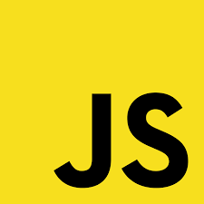

Outtake - Programming in Data Science
Choose programming language depending on purpose of the software
Scripting languages for simple routinary tasks (e.g. bash)
Python for NLP or information retrieval thanks to available packages
R for statistical analysis, especially if using advanced methods
Other languages when efficiency is key: Julia, AWK
Languages for visualization and interactive software: JavaScript, NetLogo

Slide 23
Programming paradigms
Fundamentals of programming
Programming paradigms
Good programming practices

Slide 24
Programming paradigms
Programming paradigms are a way to classify programming languages based on their features
Imperative Explicit statements that directly change a program state (data fields)
Declarative Only describe properties of the desired result, but not how to compute it
focuses on describing how a program operates.
focuses on what the program should accomplish without specifying how the program should achieve the result.

Slide 25
Programming paradigms
Programming paradigms are a way to classify programming languages based on their features
Imperative Explicit statements that directly change a program state (data fields)
Declarative Only describe properties of the desired result, but not how to compute it
Structured Logical program structure with use of structured control flow constructs, block structures and subroutines
Object oriented
groups instructions with the data they operate on in the form of “objects”

Slide 26
Programming paradigms
Programming paradigms are a way to classify programming languages based on their features
Imperative Explicit statements that directly change a program state (data fields)
Declarative Only describe properties of the desired result, but not how to compute it
Structured Logical program structure with use of structured control flow constructs, block structures and subroutines
Functional desired result is declared as the value of a series of function applications
Object oriented
groups instructions with the data they operate on in the form of “objects”

Slide 27
Programming paradigms
Programming paradigms are a way to classify programming languages based on their features
Imperative Explicit statements that directly change a program state (data fields)
Declarative Only describe properties of the desired result, but not how to compute it
Structured Logical program structure with use of structured control flow constructs, block structures and subroutines
Functional desired result is declared as the value of a series of function applications
Object oriented
groups instructions with the data they operate on in the form of “objects”

Slide 28
Imperative programming
Imperative programming focuses on describing how a program operates
instruction or command is the central construct that changes the state of the program
imperare, lat. = to order, to instruct

Slide 29
Imperative programming
Imperative programming focuses on describing how a program operates
instruction or command is the central construct that changes the state of the program
imperare, lat. = to order, to instruct
data structures to organize data
works by changing state through assignment statements
control structures govern execution of instructions
functions and procedures to structure the processing
procedural programming

Slide 30
Imperative programming
works by changing state through assignment statements
Assignments
example in Python: x = 0
Operators
example in Python: x = x + 1

Slide 31
Imperative programming
control structures govern execution of instructions
Comparisons
example in Python: x == 1
Sequences
example in Python: x += 1 print(x)
Conditions
example in Python: if x == 0: x += 1
Loops
example in Python:
for i in range(100): x += 1
Jumps
example in Python: if x == 0: x += 1 else: x -= 1

Slide 32
Imperative programming
functions and procedures to structure the processing
functions compute a value to return, procedures only perform a task
Procedure and function calls
example in Python: print(‘x is’,x)
Function definitions
example in Python:
def my_function():
print("This is my function")

Slide 33
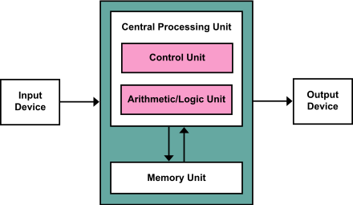
The von Neumann Architecture
The von Neumann Architecture
Imperative programming is based on von Neumann’s architecture and features close relation to machine architecture
Many general purpose computers are based on it
Source: Wikipedia

Slide 34
The von Neumann Architecture
data and instructions are stored in central memory
control unit does sequential execution of commands
instructions are fetched from memory one at a time and in order
processor decodes and executes an instruction, then fetches next instruction
data transferred from one part to another via buses
Source: Wikipedia

Slide 35
Imperative programming advantages and disadvantages
Advantages
step-by-step execution of instructions
simple to understand, easy to code
Disadvantages
code grows fast and can be confusing
higher risk of errors while editing
sequential execution: distributed execution on several processors is not easy to realize

Slide 36
Object-oriented Programming: Motivation
Why do we need object-oriented programs?
since 70s programs were getting too large (UNIX, data bases, information systems etc.)
more and more variants of the same program were needed (different versions, for different devices, different environments)
how do you manage that?

Slide 37
Object-oriented Programming: Features
Important features of Object Oriented Programming (OOP)
Bottom-up approach in program design
Programs organized around objects, grouped in classes (modularity)
Focus on data with methods to operate upon object’s data
Interaction between objects through functions
Reusability of design through creation of new classes by adding features to existing classes

Slide 38
Object
A real-world element in an object–oriented environment that may have a physical (e.g., student, customer, car) or a conceptual (e.g., project, process) existence.
Identity that distinguishes it from other objects
State that determines the characteristic properties of an object and the values of these properties for the object
Behavior that represents externally visible activities performed by an object in terms of changes in its state

Slide 39
Class
Abstract collection of objects that have the same characteristic properties and that exhibit common behavior
Blueprint or description of the objects that can be created from it
Instantiation: program instruction that creates an object belonging to a class
Composed of:
Attributes - data as variables in the object
Methods - behavior of the objects as functions that can be called
state of a given object can only be changed via method calls
a method call only change the state of the object it is applied to

Slide 40
Class and Object: An Example
class Employee:
'Common base class for all employees'
empCount = 0
def __init__(self, name, salary):
self.name = name
self.salary = salary
Employee.empCount += 1
def displayCount(self):
print "Total Employee %d" % Employee.empCount
def displayEmployee(self):
print "Name: ", self.name, ", Salary: ", self.salary
https://www.tutorialspoint.com/python/python_classes_objects.htm

Slide 41
Class and Object: An Example
class Employee:
'Common base class for all employees'
empCount = 0
def __init__(self, name, salary):
self.name = name
self.salary = salary
Employee.empCount += 1
def displayCount(self):
print "Total Employee %d" % Employee.empCount
def displayEmployee(self):
print "Name: ", self.name, ", Salary: ", self.salary
class attributes: global across all instances of the class
instance attributes: local for each instance
https://www.tutorialspoint.com/python/python_classes_objects.htm

Slide 42
Class and Object: An Example
"This creates the first object of Employee class"
emp1 = Employee("Zara", 2000)
"This creates the second object of Employee class"
emp2 = Employee("Manni", 5000)
emp1.displayEmployee()
emp2.displayEmployee()
print "Total Employee %d" % Employee.empCount
https://www.tutorialspoint.com/python/python_classes_objects.htm

Slide 43
Class and Object: An Example
"This creates the first object of Employee class"
emp1 = Employee("Zara", 2000)
"This creates the second object of Employee class"
emp2 = Employee("Manni", 5000)
emp1.displayEmployee()
emp2.displayEmployee()
print "Total Employee %d" % Employee.empCount
https://www.tutorialspoint.com/python/python_classes_objects.htm
output:
Name: Zara, Salary: 2000
Name: Manni, Salary: 5000
Total Employee 2

Slide 44
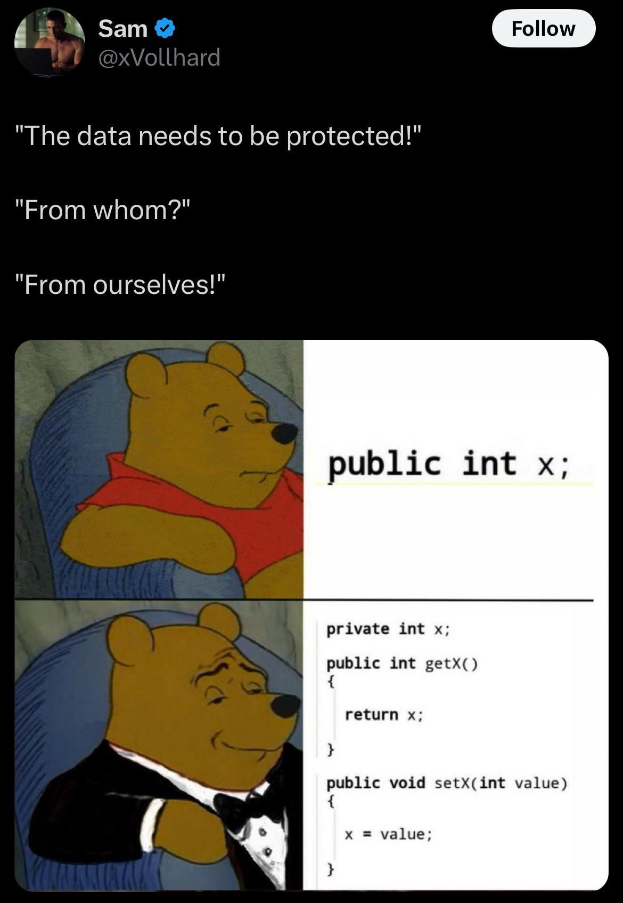
Protecting variables with OOP
https://x.com/xVollhard/status/1855510090037747830

Slide 45
OOP concepts
Encapsulation: process of binding both attributes and methods together within a class
Abstraction: class (data) attributes can only be accessed by class methods, no direct access from outside
Polymorphism: using operations in different ways, depending upon the instance they are operating upon (same name, different functions)
Message passing: objects communicate with each other by invoking methods
Inheritance: mechanism that permits new classes to be created out of existing classes by extending and refining its capabilities

Slide 46
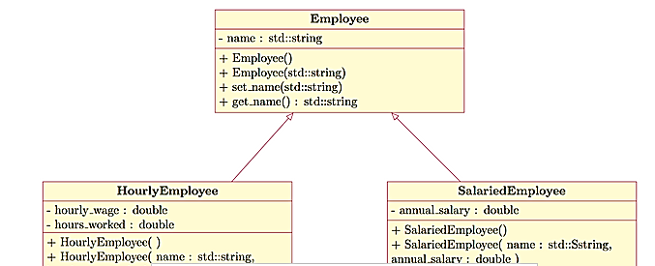
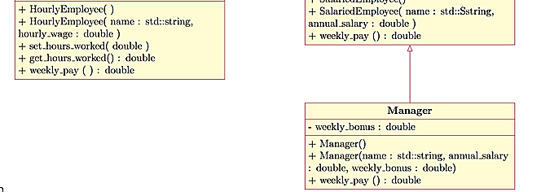
Inheritance examples
Person
Age
Gender
Social Security ID
https://www.chegg.com/homework-help/questions-and-answers/lw-231-employee-inheritance-scheme-labwork-language-c--labwork-implement-simple-class-hier-q32882678
Employee
Name
Salary
More in Theory Exercise 4

Slide 47
Object-oriented programming: advantages
clear specification of attributes and methods
all members of a class share the same properties
properties can only changed via well-specified methods
allows for very modular program structures
inheritance:
allows a hierarchical structure of objects/classes
possibility to specify specific attributes or methods only for subclass
allows for very efficient nested designs (also very code efficient)
faster development of code - modularity, reusability, easy to upgrade, clear interface descriptions, security through encapsulation and abstraction, flexibility via polymorphism
The disadvantage: code overhead for simple programs or one-person code

Slide 48
Functional programming
Declarative programming paradigm - focus on what to solve
Mathematical function as the fundamental language element
in pure mathematical function form, no assignments and no variables
result of a function depends exclusively on parameters
initiates no side effects or external impact besides the return values
no loops, hence recursion as central concept
functions can be used as parameters and return values
LISP is the most famous functional programming language
In Python: lambda functions (see assignments)

Slide 49
Functional programming example: LISP
(defun factorial (n)
(if (= n 0)
1
(* n (factorial (- n 1))) ) )
(loop for i from 0 to 16
do (format t "~D! = ~D~%" i (factorial i)) )
Code with function to calculate factorial values between 0! and 16!
Prefix syntax
e.g. subtracting 1 from n is (- n 1)
No instructions, only function calls
e.g. ( if condition clasuseIf clauseElse)
We will learn much more about this in Session 6

Slide 50
Functional programming
Advantages
simple to parallelize since they do not change any variables or data outside it
automatic memory management is easy
lazy evaluation possible - value is evaluated and stored only when it is required
Disadvantages
unusual notation, could lead to reduced readability of code
partially inefficient, especially combination of immutable values and recursion

Slide 51
Good programming practices
Fundamentals of programming
Programming paradigms
Good programming practices

Slide 52
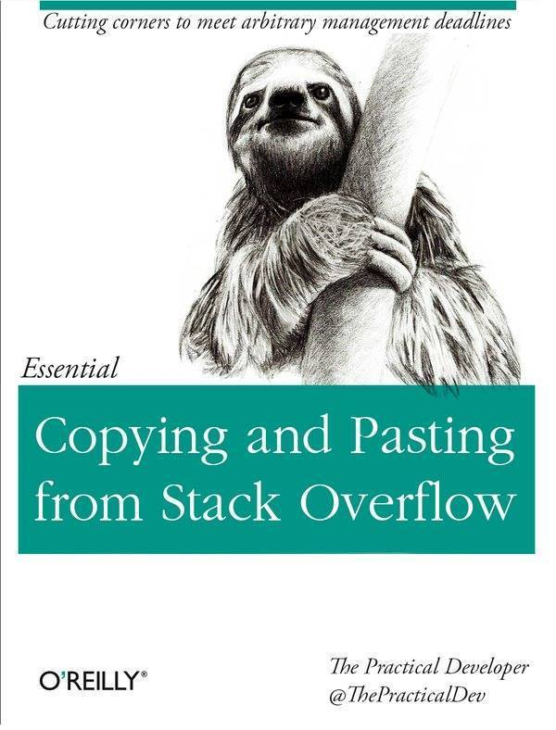
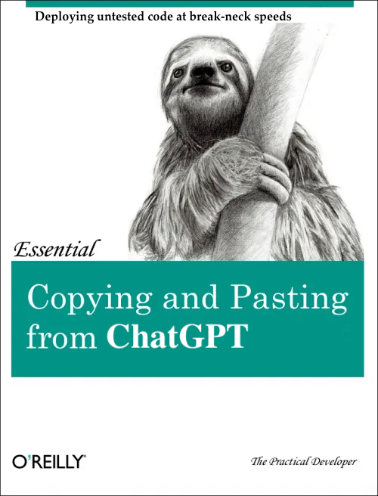
Avoiding dangerous coding practices

Slide 53
Structured flow
Unstructured flow has breaks or jumps:
while i > 0:
if i == 100:
break
Solution:
Use only while, for, and do/while to control flow
Never use goto, break, or continue

Slide 54
Structured flow
Excessive control flow:
if x > 0:
if x > 1:
if x > 2:
print(“more than 2”)
Solution:
Careful planning of flow with flow charts (session 6)
Write pseudocode first in paper, then start programming

Slide 55
Readable code
Avoid cryptic variables:
usersList better than ulst or l
result better than res - also something more specific
pageNumber better than pnum
remainder better than modres
Solution: ask yourself if the role of the variable can be understood without scrolling (i.e. in a few lines of code)

Slide 56
Readable code
Avoiding magic numbers: constants that you repeat in the code and should have been a variable set once. Problematic for interpretation
https://code-basics.com/languages/python/lessons/magic-numbers
Solution: if you hardcode the same number or string more than once, declare it as a constant
euros_count = 1000
dollars_count = euros_count * 1.25 # 1250.0
rubles_count = dollars_count * 60 # 75000.0
print(rubles_count)
dollars_per_euro = 1.25
rubles_per_dollar = 60
euros_count = 1000
dollars_count = euros_count * dollars_per_euro # 1250.0
rubles_count = dollars_count * rubles_per_dollar # 75000.0
print(rubles_count)

Slide 57
Readable code
Code comments: help your future you understanding your code. Comments explain why, not how
Example above with too many comments. https://realpython.com/python-comments-guide/ No need to comment each line but everything not trivial
# A dictionary of families who live in each city
mydict = {
"Midtown": ["Powell", "Brantley", "Young"],
"Norcross": ["Montgomery"],
"Ackworth": []
}
def a(dict):
# For each city
for p in dict:
# If there are no families in the city
if not mydict[p]:
# Say that there are no families
print("None.")

Slide 58
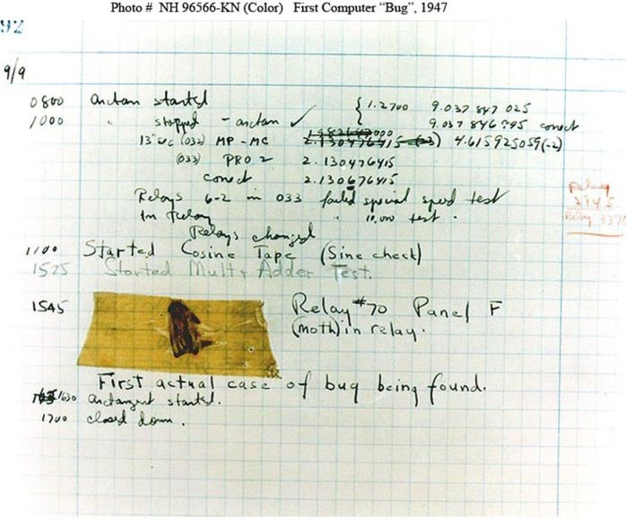
Software bugs
Definition
A software bug is a flaw in a program that makes it produce a result different than what it was intended for.
The most common bugs are design flaws in the code of programs
Debugging is the task of finding and fixing bugs
Most software developers spend more time fixing bugs than coding
First (literal) bug in a computer https://education.nationalgeographic.org/resource/worlds-first-computer-bug

Slide 59
Bug example
def isPal(x):
temp = x
temp.reverse()
if temp == x:
return True
else:
return False
def silly(n):
for i in range(n):
result = []
elem = input('Enter element: ')
result.append(elem)
if isPal(result):
print('Yes')
else:
print('No')
isPal() assumes x is a list
Returns True if the list is a palindrome; False otherwise
sily() assumes n is an int > 0, gets n inputs from user
Prints 'Yes' if the inputs form a palindrome;
'No' otherwise

Slide 60
Bug example
>>> silly(4)
Enter element: a
Enter element: b
Enter element: b
Enter element: a
Yes

Slide 61

Bug example
>>> silly(2)
Enter element: a
Enter element: b
Yes
>>> silly(4)
Enter element: a
Enter element: b
Enter element: b
Enter element: a
Yes

Slide 62
Bug example
>>> silly(2)
Enter element: a
Enter element: b
Yes
>>> silly(4)
Enter element: b
Enter element: a
Enter element: b
Enter element: a
Yes
>>> silly(4)
Enter element: a
Enter element: b
Enter element: b
Enter element: a
Yes

Slide 63
Finding bugs
def isPal(x):
temp = x
temp.reverse()
if temp == x:
return True
else:
return False
def silly(n):
for i in range(n):
result = []
elem = input('Enter element: ')
result.append(elem)
print(result)
if isPal(result):
print('Yes')
else:
print('No')
Checking intermediate values within the program to check if the bug was before or afterwards

Slide 64
Finding bugs
>>> silly(4)
Enter element: b
Enter element: a
Enter element: b
Enter element: a
['a']
Yes
>>> silly(2)
Enter element: a
Enter element: b
['b']
Yes

Slide 65
Finding bugs
def isPal(x):
temp = x
temp.reverse()
if temp == x:
return True
else:
return False
def silly(n):
result = []
for i in range(n):
elem = input('Enter element: ')
result.append(elem)
print(result)
if isPal(result):
print('Yes')
else:
print('No')
Checking intermediate values within the program to check if the bug was before or afterwards

Slide 66
Finding bugs
>>> silly(4)
Enter element: b
Enter element: a
Enter element: b
Enter element: a
['b',’a’,’b’,a’]
Yes
>>> silly(2)
Enter element: a
Enter element: b
['a','b']
Yes

Slide 67
Bug example
def isPal(x):
temp = x
temp.reverse()
if temp == x:
return True
else:
return False
def silly(n):
result = []
for i in range(n):
elem = input('Enter element: ')
result.append(elem)
print(result)
if isPal(result):
print('Yes')
else:
print('No')
Now we know that a second bug must
be in the code that executes after
print(result)

Slide 68
Bug example
def isPal(x):
temp = x
temp.reverse()
if temp == x:
return True
else:
return False
def silly(n):
result = []
for i in range(n):
elem = input('Enter element: ')
result.append(elem)
if isPal(result):
print('Yes')
else:
print('No')
Now we know that a second bug must
be in the code that executes after
print(result)

Slide 69
Bug example
def isPal(x):
temp = x[:]
temp.reverse()
if temp == x:
return True
else:
return False
def silly(n):
result = []
for i in range(n):
elem = input('Enter element: ')
result.append(elem)
if isPal(result):
print('Yes')
else:
print('No')
with [:] we create a copy of x in temp

Slide 70
Bug example
>>> silly(2)
Enter element: a
Enter element: b
No
>>> silly(4)
Enter element: b
Enter element: a
Enter element: b
Enter element: a
No
>>> silly(4)
Enter element: a
Enter element: b
Enter element: b
Enter element: a
Yes

Slide 71
Next Session
Algorithms
Representation of algorithms
Abstract data structures: Graphs

Slide 72

Appendix: Esoteric programming languages
Brainfuck: trying to have the smallest compiler
LOLCODE:
Piet: programming with images as code. Example: Hello world
Whitespace: code only composed of space, tab, and line breaks. Cannot be printed.
++++++++[>++++[>++>+++>+++>+<<<<-]>+>+>->>+[<]<-]>>.>---.+++++++..+++.>>.<-.<.+++.------.--------.>>+.>++.
HAI
CAN HAS STDIO?
VISIBLE "HAI WORLD!"
KTHXBYE

